Slide 1
CSE308:COMPUTING PRACTICUM-IV
Unit 3: . Tuning System Performance
• Adjusting Tuning Profiles
• Influencing Process Scheduling
Outcome: Understand Bash scripts to schedule various tasks

Slide 2
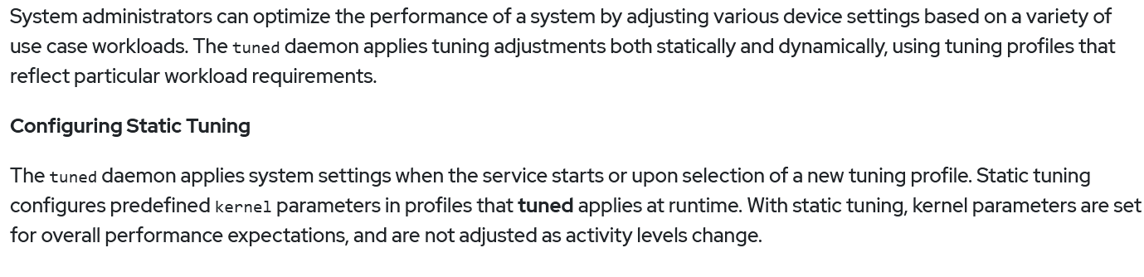
Tuning System Performance
Why write shell scripts?
To avoid repetition:
If you do a sequence of steps with standard Unix commands over and over, why not do it all with just one command?
To automate difficult tasks:
Many commands have subtle and difficult options that you don’t want to figure out or remember every time.

Slide 3
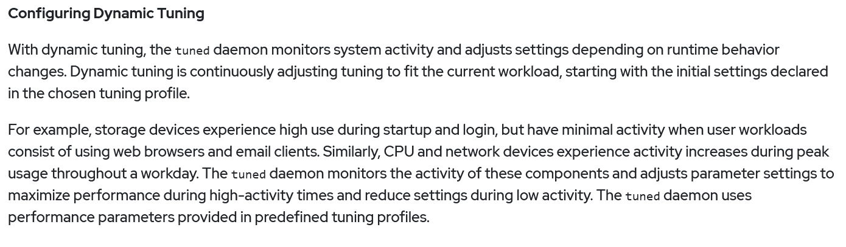
Tuning System Performance

Slide 4
%temp% prefetch Disk cleanup Optimize your disk drive Go for various tuneup utilities
Ways to increase the system Speed(Windows)

Slide 5
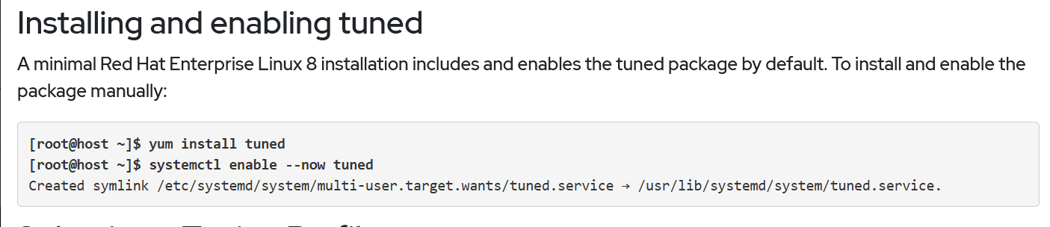
Tuning System Performance

Slide 6
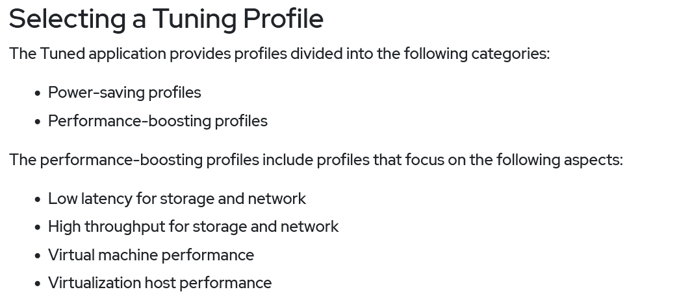
Tuning System Performance

Slide 7
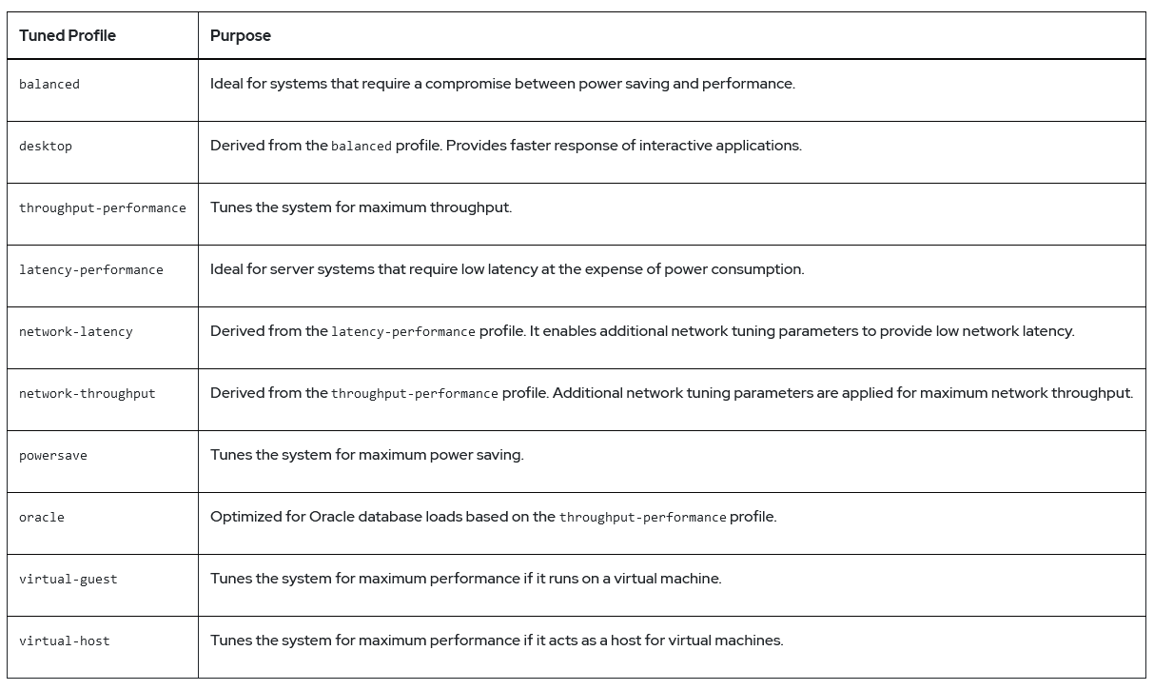
Tuning System Performance

Slide 8
Tuning System Performance (Commands)
yum repolist all
Yum remove tuned
Yum list tuned
Systemcltl is-enabled tuned
Systemctl is-active tuned
Systemctl status tuned
Sudo tuned-adm list
tuned-adm active

Slide 9
Tuning System Performance (Commands)
tuned-adm list
tuned-adm profile throughput-performance
tuned-adm active
tuned -adm recommend
tuned-adm off
tuned-adm active

Slide 10
Tuning System Performance (Commands)
tuned-adm active
tuned -adm recommend
tuned-adm off
tuned-adm active

Slide 11
Influencing Process Scheduling
Commands to check the processing of your system (means processing utilization)
ps and top command
Prioritize and de-prioritize specific processes with nice and renice
There are 40 nice values
20 is the central one

Slide 12
Influencing Process Scheduling
<20 are towards higher priority
>20 are towards less priority
Open three terminals and start three tasks such as
1st terminal vim file1.txt
2nd terminal vim file2.txt
3rd terminal vim file3.txt

Slide 13
Influencing Process Scheduling
Use this command : ps ao user,nice,priority,command
Check for nice values and priority
nice –n -5 cim filename1.txt
And check it by using first command

